Slide 1

Department of IOT & Robotics Engineering
Program in IOT & Robotics Engineering
Course Code: ICT 4252
Course Title: Object Oriented Programming Lab.
Presentation
SUBMITTED BY:
Group no:11
Group members:
Rakib Hasan
Id: 1801047
Session:2018-19
Fardin Ahmed Ashan
Id: 2001033
Session:2020-21
SUBMITTED TO:
Farzana Akter
Lecturer, Department Of IO& Robotics Engineering, BDU.

Slide 2
Title
Introduction
Objectives
TABLE OF
CONTENTS
Related works
Methodology
Expected Outcome
Conclusion
Reference

Slide 3
Project Title
S M S
STUDENT MANAGEMENT SYSTEM

Slide 4
Recognizing the transformative potential of technology-enhanced learning, we have developed a ’Student Management System’ designed to revolutionize the educational landscape. This Java-based system caters to the dual needs of students and administrators, with a primary goal of empowering learning experiences. The application empowers students to seamlessly register, manage their profiles, and make informed choices about their education, while administrators gain a robust set of tools to oversee and facilitate this process.
Introduction

Slide 5
Increasing the efficiency of college or school students’ record management.
Decrease time required to access and deliver student records.
To ensure data integrity, privacy and security in an open-access environment.
Objectives

Slide 6
1. “Web-Based Student Information Management System”- by R. Khalid, S. Ahmad, and A. Abdul Rab
2. “Development of a Student Academic Record Management System”- by A. Adeleke, O. Afolayan , and B . Adewale .
3. “An Efficient Student Enrollment System Using Biometric Authentication”- by S. Singh and R. Kapoor
4. “Improving Student Management with Learning Analytics”-by S. Singh and R. Kapoor
Related
Works

Slide 7
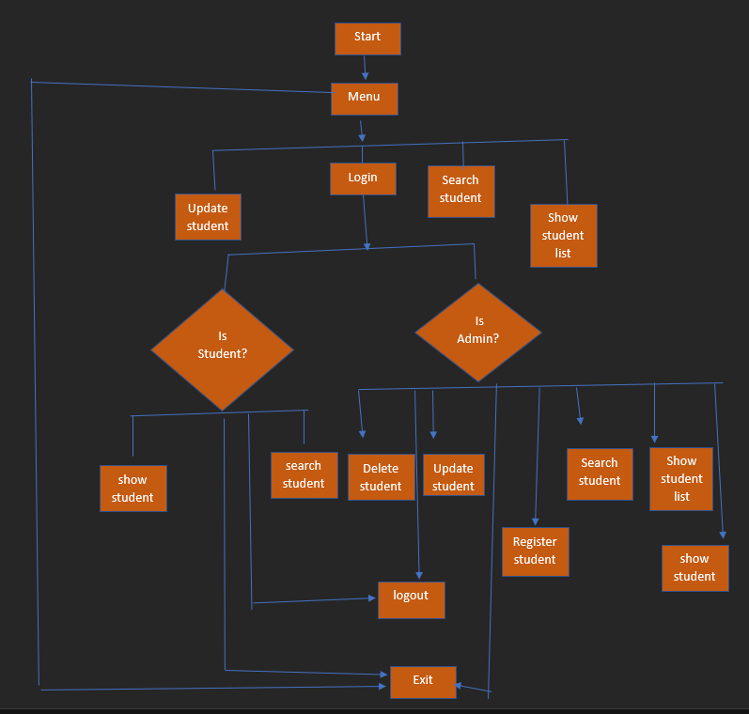
Flow Chart

Slide 8
The project will be implemented in the following phases:
User and Student Classes
User Manager Class
User Authentication
Student Registration
Student Information Control
Console-Based Interface
Methodology

Slide 9
After completing this project , User can be able to –
1. register of a student.
2.see the list of registered students.
3.search the registered students.
4. update the registered students.
5.delete the registered students.
Expected Outcome

Slide 10
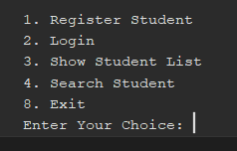
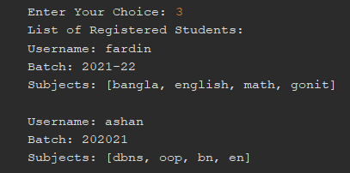
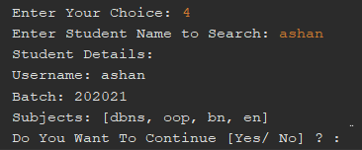
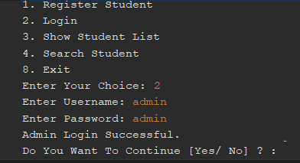
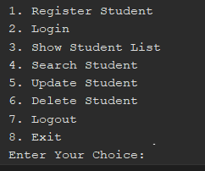
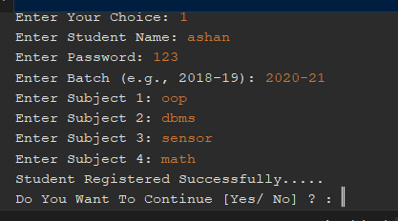
Screenshot

Slide 11
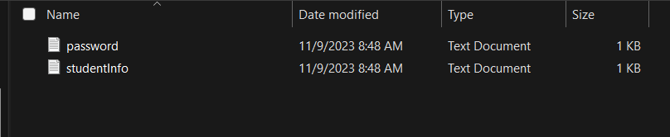
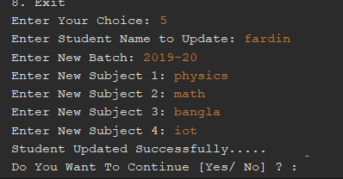
Screenshot

Slide 12
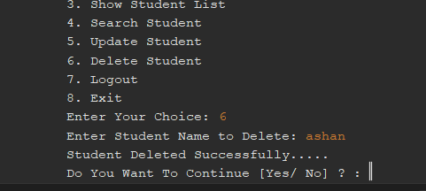
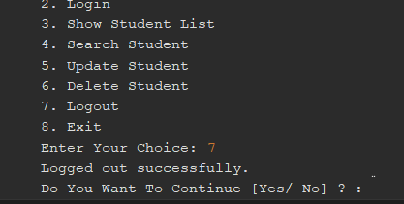
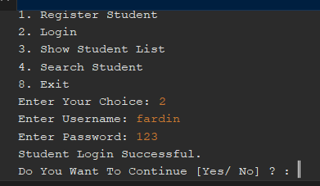
Screenshot

Slide 13
After completing this project, it will be helpful to maintain all data of a student. And admins can show information of their choice at any time.
Conclusion

Slide 14
https://www.geeksforgeeks.org/student-data-management-c/
https://www.programiz.com/cpp-programming/oop
https://www.w3schools.com/cpp/cpp_oop.asp
https://www.freecodecamp.org/news/what-is-object-oriented-programming/
Reference

Slide 15
THANK YOU

